Slide 1


Reception – Early Years Foundation Stage
WELCOME TO
Shephalbury Park Primary School
Thursday 8th October 2026
3.30pm
Notes:
Insert the school logo, date, time and name of presenter
Encourage parents to look around the classroom/provision for the first 10 minutes.
Room Set up – Think about the best way to arrange the seating, keeping in mind that you will want all parents to see the presentation and to be able to talk in small groups. You may want to play music and offer refreshments as parents arrive.
Give out induction packs as parents enter and keep a register so that you know who has attended.
Make sure the evaluation sheets/post-its and pens/pencils are on the chairs/tables for parents to access during the induction.
Welcome the parents/carers and introduce yourself

Slide 2


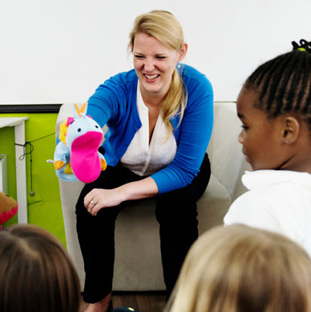

AIMS of the meeting
To give you an overview of
Early Years Foundation Stage (EYFS)
and what your child will be learning
To provide ideas we can effectively work together
and how you can best support your child at home
To help you understand what to
expect from us
Notes:
Insert own school photos
The curriculum for every child under the age of 5
Parents as partners
What this school does specifically – policies, expectations etc

Slide 3

Notes:
Insert own school photos
The curriculum for every child under the age of 5
Parents as partners
What this school does specifically – policies, expectations etc

Slide 4
What will my child be learning?
Prime Areas of Learning | Specific Areas of Learning
Personal, Social and Emotional | Literacy
Communication and Language | Mathematics
Physical Development | Understanding the World
 | Expressive Arts and Design
Notes:
Use a piece of video to support discussions about children’s learning in relation to the areas of learning in the EYFS. It is best to use a video from your school/setting which shows children involved in child-initiated play. Ask the parents/carers what they think the children are learning and relate to the Prime and Specific areas of learning to demonstrate learning in the EYFS.
The purpose of this is to emphasis learning through play and how high-quality play will involve many of the areas of learning. Explain the adult role’s in supporting and extending learning through play. Emphasise how every child is unique, developing at their own rates, and in their own ways.

Slide 5

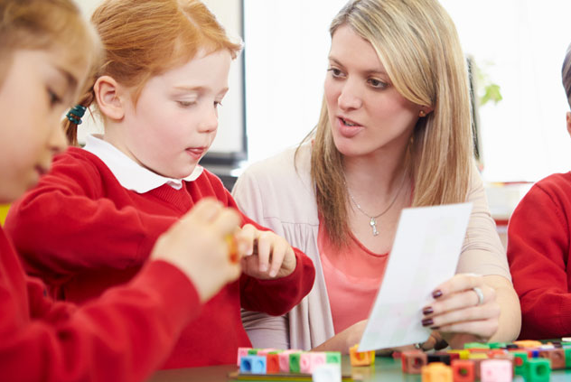

How does my child learn?
Characteristics of effective teaching and learning
Three characteristics of effective teaching and learning are:
playing and exploring - children investigate and experience things, and ‘have a go’
active learning - children concentrate and keep on trying if they encounter difficulties, and enjoy achievements
creating and thinking critically - children have and develop their own ideas, make links between ideas, and develop strategies for doing things
Notes:
School insert own photos
Explain that alongside the Areas of Development we look at the ways in which children learn.
The focus of the CoEL is on how children learn rather than what they learn i.e. process over outcome. This allows for teachers/practitioners to provide the right type of learning opportunities.
Optional to do the following dependent on the needs of your community and parents/carers
Activity - ask the parents to look at the photographs and discuss which of the characteristics of effective learning they think the child/children might be demonstrating.
Alternatively: Share some of your own photographs and provide examples of how the children are learning through play

Slide 6
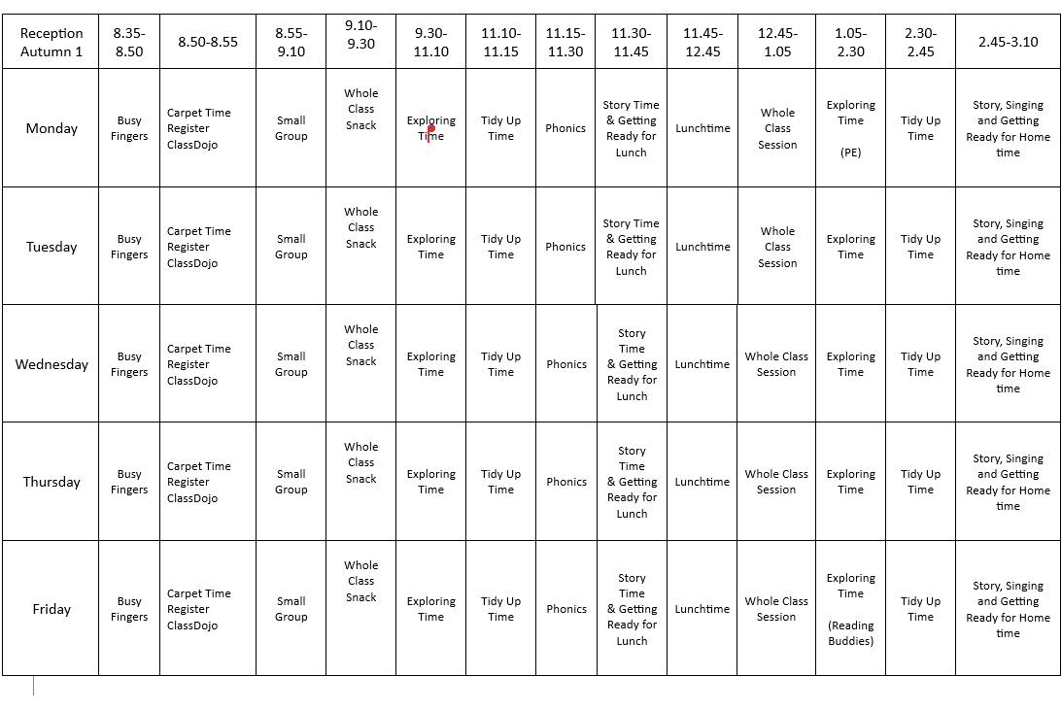
Notes:
Insert the school’s/setting’s routine using parent friendly language and the lead person explaining what each part of the routine means.
Go through this and explain each session eg. child initiated activities and self-registration
Suggestion – add a photo of the school’s/setting’s visual timetable
Remember routines are adaptable throughout the year and change in response to the cohorts needs

Slide 7
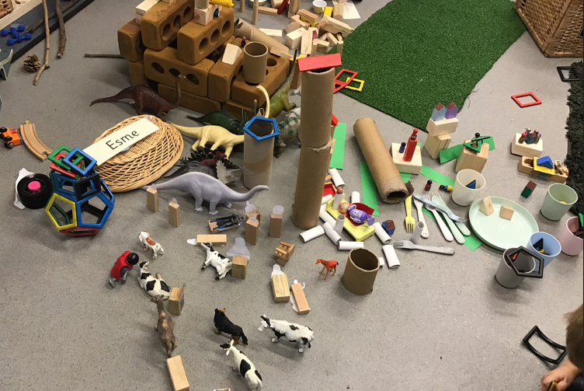
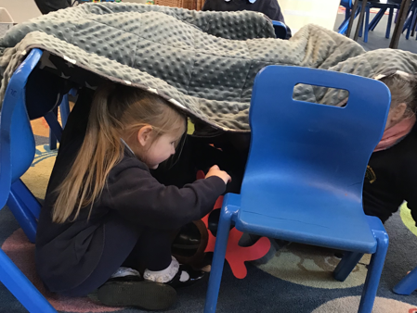
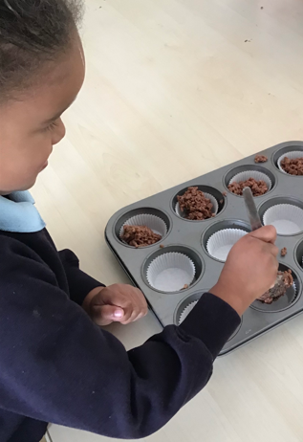
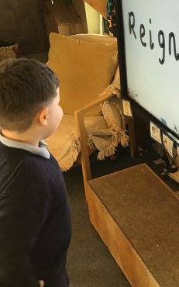
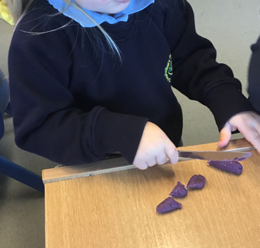
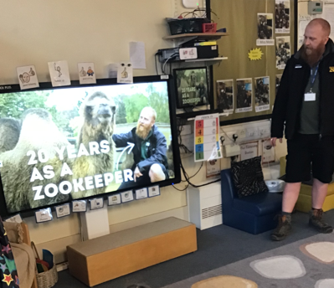
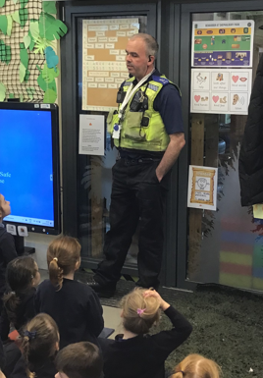
How will my child learn?
Notes:
Optional (or you may want to use this at a second session)
If preferred insert photos of the ways in which children learn in your school/provision.
Consider displaying examples resources used in school to support learning for parents/carers to explore.
Optional to do the following dependent on the needs of your community and parents/carers
Activity – Parents look at each of the photos and consider what is being learnt/developed. Encourage parents to discuss what they can see and what children might be learning in these situations. Parents/carers to be given a copy of the photos on the slide so that they can make notes and take it away to share with other family members.
In the discussion following the activity give a short explanation of why the activity in each photo is beneficial e.g. hanging from bars to build upper body strength (writing), listening to adults read a book (story time), board games (mathematics), sand/water play (problem solving), clearly labelled drawers/shelves (independence), role-play/collaborative play (make friends).

Slide 8
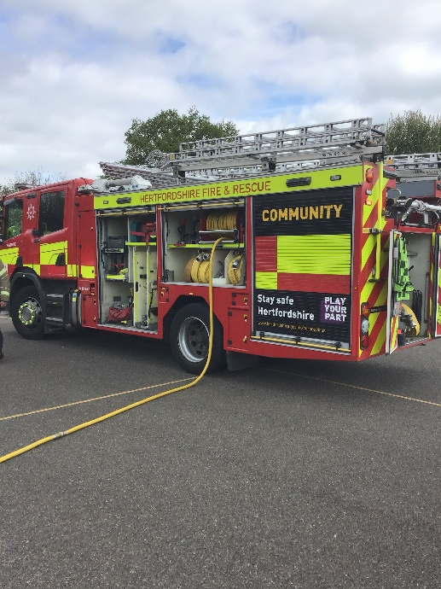
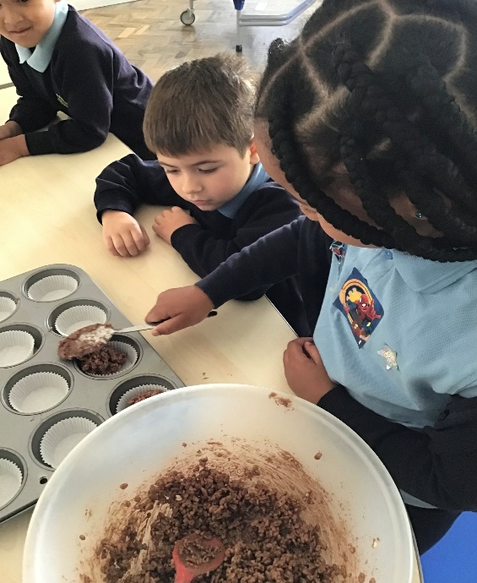
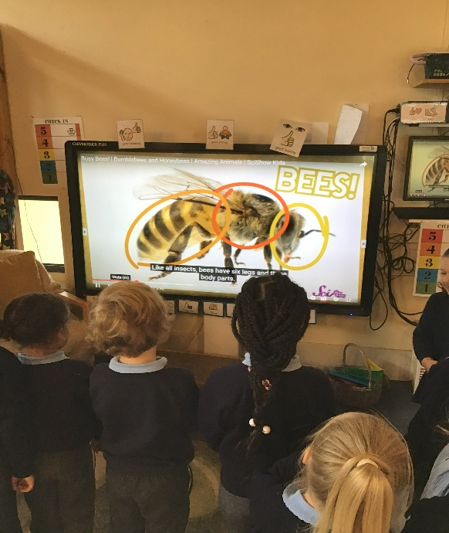
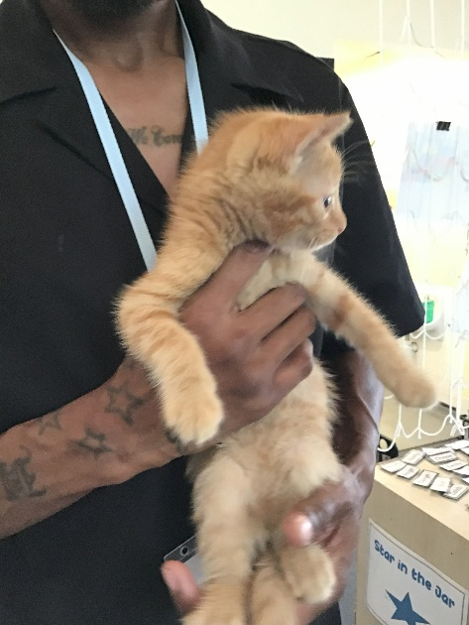
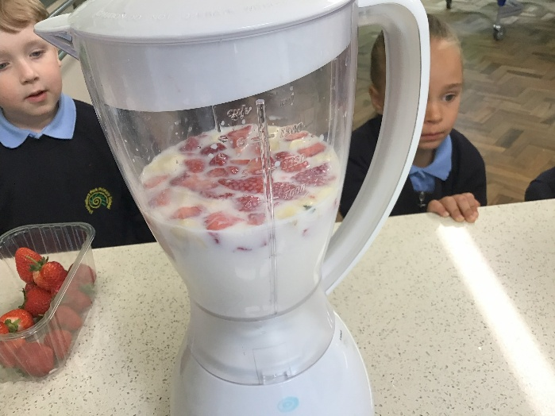
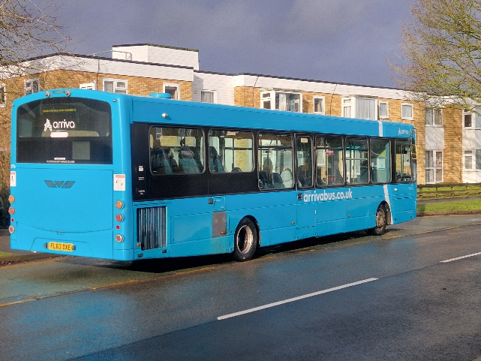
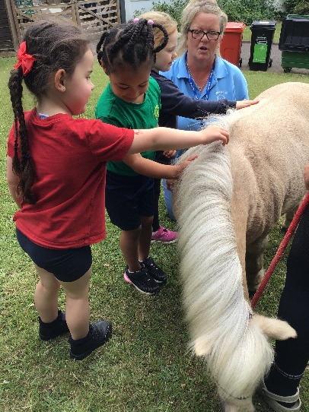
Real experiences – Following the interests of the children
Notes:
Optional (or you may want to use this at a second session)
If preferred insert photos of the ways in which children learn in your school/provision.
Consider displaying examples resources used in school to support learning for parents/carers to explore.
Optional to do the following dependent on the needs of your community and parents/carers
Activity – Parents look at each of the photos and consider what is being learnt/developed. Encourage parents to discuss what they can see and what children might be learning in these situations. Parents/carers to be given a copy of the photos on the slide so that they can make notes and take it away to share with other family members.
In the discussion following the activity give a short explanation of why the activity in each photo is beneficial e.g. hanging from bars to build upper body strength (writing), listening to adults read a book (story time), board games (mathematics), sand/water play (problem solving), clearly labelled drawers/shelves (independence), role-play/collaborative play (make friends).

Slide 9
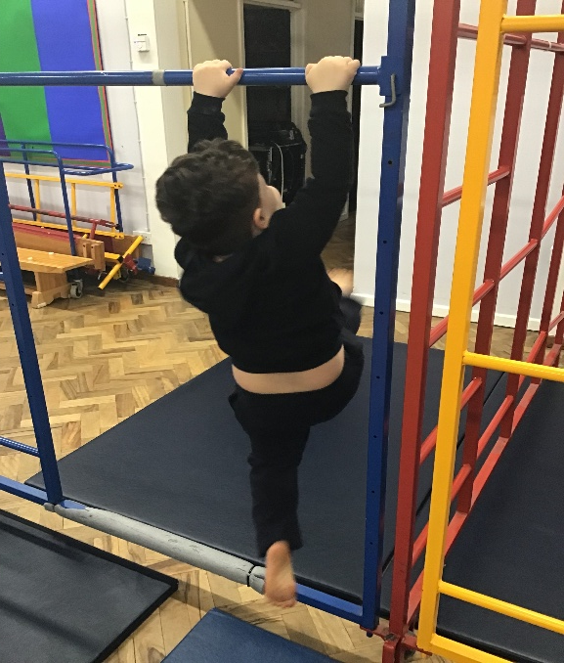
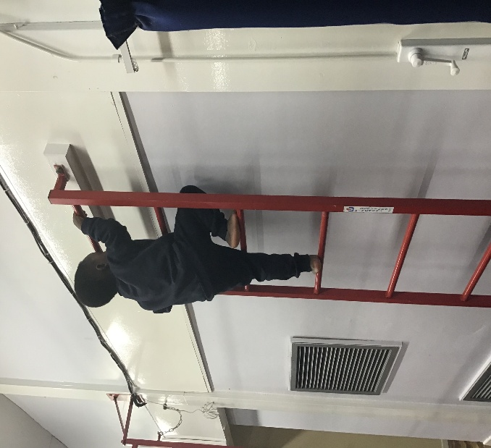
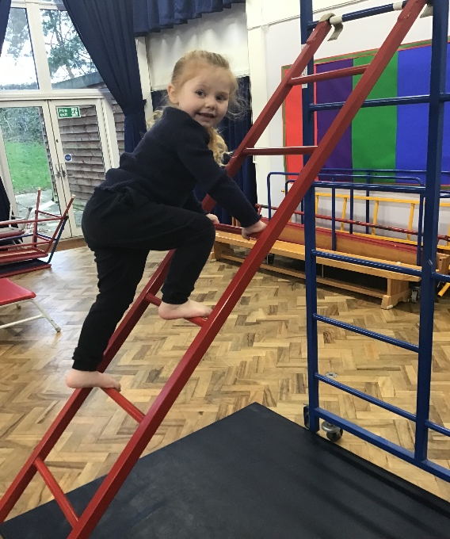
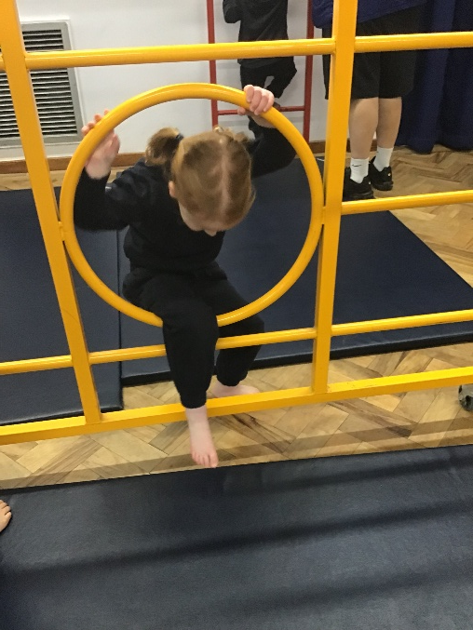
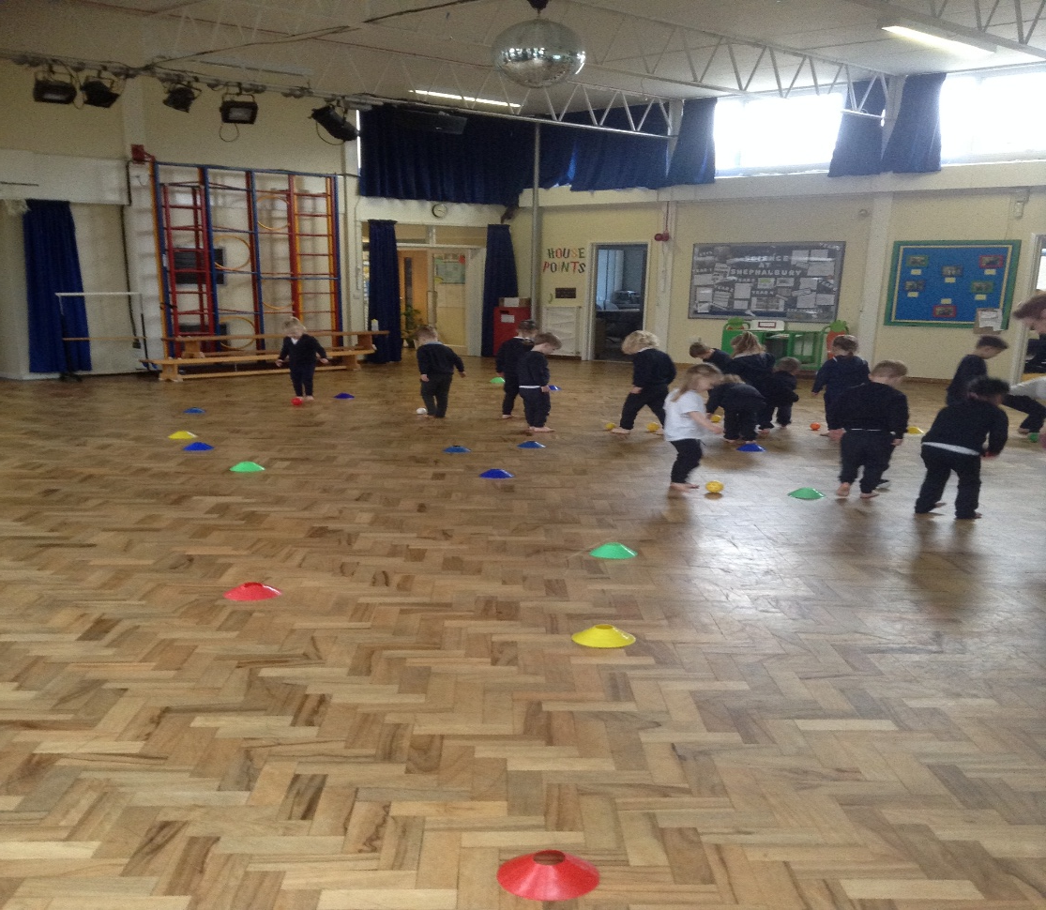
PE- Every Monday Afternoon
Notes:
Optional (or you may want to use this at a second session)
If preferred insert photos of the ways in which children learn in your school/provision.
Consider displaying examples resources used in school to support learning for parents/carers to explore.
Optional to do the following dependent on the needs of your community and parents/carers
Activity – Parents look at each of the photos and consider what is being learnt/developed. Encourage parents to discuss what they can see and what children might be learning in these situations. Parents/carers to be given a copy of the photos on the slide so that they can make notes and take it away to share with other family members.
In the discussion following the activity give a short explanation of why the activity in each photo is beneficial e.g. hanging from bars to build upper body strength (writing), listening to adults read a book (story time), board games (mathematics), sand/water play (problem solving), clearly labelled drawers/shelves (independence), role-play/collaborative play (make friends).

Slide 10
Phonics
Phase Two Phonics is an essential part of early literacy. It builds on Phase One, which focuses on developing basic listening skills and understanding the sounds of language. Phase Two helps children start to read and spell simple words by teaching them individual letter sounds and the corresponding graphemes (letters or letter combinations that represent those sounds).
Little Wandle: In Phase Two, children are introduced to 32 phonemes (sounds), represented by letters and letter combinations. These phonemes are taught in a specific order, which helps children gradually learn to blend sounds to read words and segment words to spell them.
Sounds and Corresponding Graphemes: Each sound is taught with its corresponding letter or letters (graphemes).
We will have an additional meeting later in the year on ways in which you can support your child further with phonics at home.
Notes:
Optional (or you may want to use this at a second session)
If preferred insert photos of the ways in which children learn in your school/provision.
Consider displaying examples resources used in school to support learning for parents/carers to explore.
Optional to do the following dependent on the needs of your community and parents/carers
Activity – Parents look at each of the photos and consider what is being learnt/developed. Encourage parents to discuss what they can see and what children might be learning in these situations. Parents/carers to be given a copy of the photos on the slide so that they can make notes and take it away to share with other family members.
In the discussion following the activity give a short explanation of why the activity in each photo is beneficial e.g. hanging from bars to build upper body strength (writing), listening to adults read a book (story time), board games (mathematics), sand/water play (problem solving), clearly labelled drawers/shelves (independence), role-play/collaborative play (make friends).

Slide 11
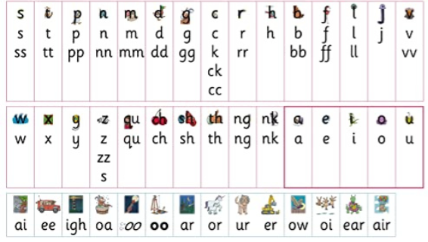
Phonics – Grapheme chart

Slide 12
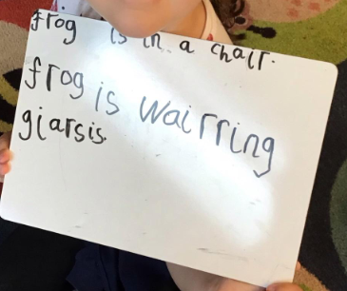
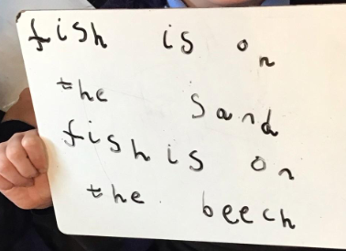
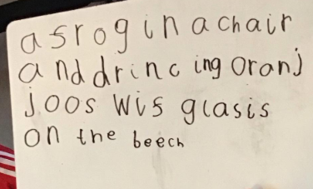
Writing

Slide 13

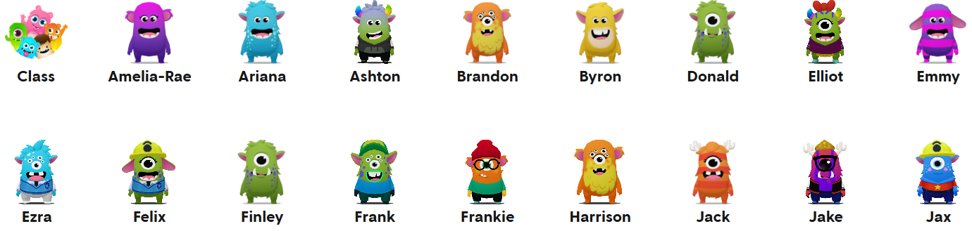


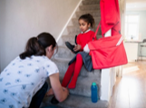
How can I support my child at home?
Send in home learning for your child to share with the class.
Physical activities to develop gross and fine motor movements
Have a bedtime story every night and listen to your child read at home.
When you are out and about draw attention to shapes and numbers in shops or in the street. Sing number rhymes together
Encourage independence at home
Notes:
Explain that as the children progress through the school/setting they will be asked to help children at home with various activities (home learning), such as reading a book together. Their cooperation with these activities will be most appreciated and help their child to do well at school or nursery. Always speak of school/setting positively and if issues do occur they then need to be addressed in the appropriate manner (school/setting policy).
As you talk about each photograph explain how parents can help at home by using either your own ideas or some of the suggestions below.
Communicate and talk with your child - use every opportunity to have conversations with your child - play together, draw attention to objects in the environment, talk about and recall past experiences, cook together and encourage them to talk about their feelings. For example, talk about things that make them happy/unhappy.
Enjoy physical activities together - plan outdoor experiences such as visits to the park and walks. Encourage running, climbing, jumping, swinging and throwing games. Help the development of smaller muscles through cooking experiences, the use of playdough, building with bricks/Lego and opportunities to make marks and draw.
Fun with maths – play board or card games, count objects and compare them e.g. you have 3 and I have 4; I have more. Use opportunities at mealtimes e.g. you have 4 carrots on your plate, if you eat one how many will be left? During bath time use toys and containers that encourage filling and pouring; talking about things that are full and empty. When you are out and about draw attention to shapes and numbers in shops or in the street. Sing number rhymes together.
Read, tell and make up stories together- join the library and share books together, talk about the pictures and the print. Point out words that begin with the same letter as their own name and look for objects that begin with the same sound. Look for signs to read when you are out and about. Have a box available for your child that contains paper, notebooks, old envelopes, glue sticks, scissors and different writing tools, such as pens and pencils
Support your child to do things by themselves – let children put on their shoes/coats and do them up. Encourage them to wash their own hands, open food packets, use cutlery and say when they need the toilet or a drink.
Encourage social interactions - play together, encourage them to not interrupt, model taking turns and sharing. Model how to ask for something. Arrange times to play with other children. For example, meeting another family at the park

Slide 14
We support learning at home in a variety of ways
Look out for:
Learning Review meetings ( parents' evenings)
Parent/carer workshops
Information and tips in newsletters, on social media and the school website
Home/school learning packs
Open door policy
Reading books - read to your child everyday and record in reading record
Library trolley – take a book home at the end of the day
Stay and Play sessions
ClassDojo – home learning achievements
Notes:
Adapt this slide to reflect activities that your school provides to support parents/carers to help their child to learn at home. You may want to use photographs of the activities rather than text
Children learn best when we work together. Outline what is expected of parents/carers regarding homework etc.

Slide 15

Observation and assessments
Observation is simply watching and listening carefully to
see how children play, learn, and grow
It tells us:
What your child enjoys
What your child can do
What your child is learning next
What it means for your child:
It helps us to:
Wow moments are shared with parents via ClassDojo
Offer the right level of challenge (not too easy, not too hard).
Encourage independence and confidence.
Support important life skills like problem-solving, sharing, and communication.
Celebrate achievements and share progress with you.
Planning activities .
Creating the right environment
Knowing when to step in and support/extend
Notes:
Adapt this slide to reflect activities that your school provides to support parents/carers to help their child to learn at home. You may want to use photographs of the activities rather than text
Children learn best when we work together. Outline what is expected of parents/carers regarding homework etc.

Slide 16
Early Years Profile
Is a statutory assessment of a child's development at the end of the academic year. There are 17 early learning goals your child will be assessed against. For each goal, a child is marked as either "expected" or "emerging" (not yet reaching the expected level)
Good Level of Development:
A child reaches GLD if they are expected in the following areas:
Communication and language; personal, social and emotional development; physical development; literacy; and mathematics.
It acts as an overall indicator that a child is ready for the National Curriculum in Year 1.

Slide 17

Supporting individual needs
Our SENCO is
Mrs Klust
Notes:
Insert the name and photo of the SENCo
If you are concerned about your child's learning and development discuss this with the class teacher or their key person
The school's Special Educational Needs Coordinator (SENCo) supports children who need additional help
Children are helped if they need support with toileting or continence issues
Explain that, after consultation with parents/carers, the school/setting can provide a range of additional help for children who need further support with their learning and development, this may include the support of other professionals, individual learning plans and for a small number of children an Education and Health Care Plan (EHCP). Parents are consulted and involved in any discussions and decisions about their child.
Explain how the school/setting helps children with toileting and continence issues.
See the HFL Incontinence Guidance (Coping with Incontinence - Supporting children with continence issues in early year’s settings and schools) which is provided as part of the transition materials.

Slide 18

Notes:
Insert the name and photo of the SENCo
If you are concerned about your child's learning and development discuss this with the class teacher or their key person
The school's Special Educational Needs Coordinator (SENCo) supports children who need additional help
Children are helped if they need support with toileting or continence issues
Explain that, after consultation with parents/carers, the school/setting can provide a range of additional help for children who need further support with their learning and development, this may include the support of other professionals, individual learning plans and for a small number of children an Education and Health Care Plan (EHCP). Parents are consulted and involved in any discussions and decisions about their child.
Explain how the school/setting helps children with toileting and continence issues.
See the HFL Incontinence Guidance (Coping with Incontinence - Supporting children with continence issues in early year’s settings and schools) which is provided as part of the transition materials.

